Slide 1
Composition II
Advanced concepts

Slide 2
composition
The way that you arrange elements in your photo.
The way you do this determines the mood or ideas you want to express with the image.
“...how you build a picture, what a picture consists of, how shapes are related to each other, how spaces are filled, how the whole thing must have a kind of unity” Paul Strand

Slide 3
Composition
Please remember, the process of photography is the process of selection from reality – real scenes and events.

Slide 4
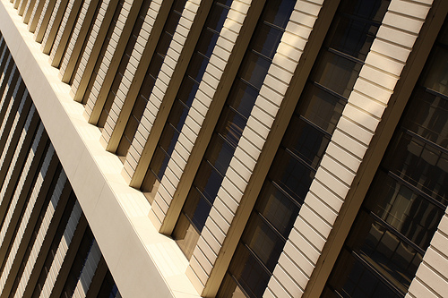
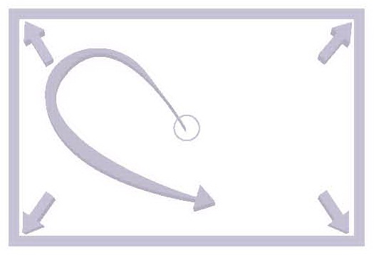
The Frame
Depending on the subject and the editing the photographers chooses, the frame can either have a weak or a strong effect on the image.

Slide 5
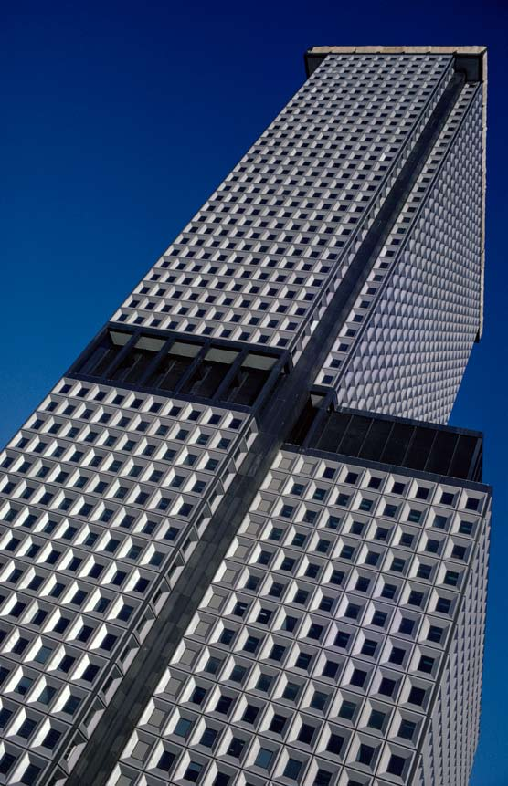
Note the alignment of the top and right edges of the building with the frame.
What effect does it have on “cluter” in the image?

Slide 6
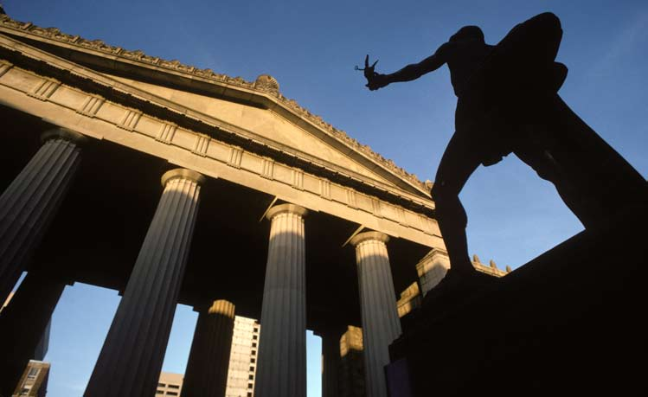
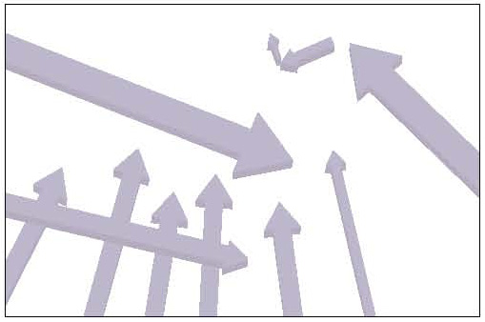
The frame
Note the way the eye moves across the frame. Which lines does it follow?

Slide 7
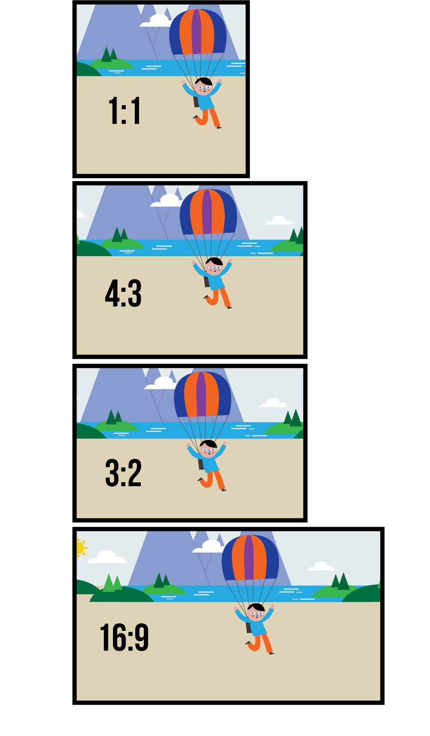
Frame shape
Aspect ratio
This is the width-to-height ratio of an image or display. Here, for consistency, we assume the width is longer, unless referring to a specific vertical image. So, a standard SLR frame is 3:2, but composed vertically is 2:3.
This does not apply to Four Thirds and compact cameras.

Slide 8
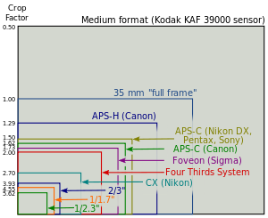
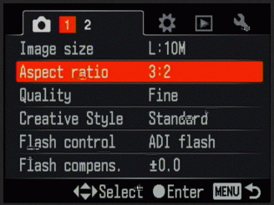

Slide 9
Frame shape – aspect ratio
Most cameras that offer aspect ratio selection have settings such as 3:2, 4:3, 1:1, 16:9 and 5:4, but you can compose images in any ratio with a little imagination.
Square format (1:1) – good for symmetrical composition. Need to be very precise.
16:9 – very good for landscapes (give a panorama-like feel)
5:4 – good choice for portraits.

Slide 10
3:2 frame
No aestetic reason why this format exists.
Generally people prefer wider images for horizontal shots and less high images for vertical shots.
3:2 frame is best when shooting verticals.
For horizontals, it is not wide enough.

Slide 11
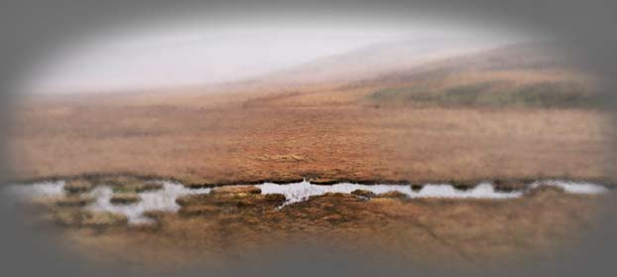
Human vision
Our natural view of the world is binocular and horizontal.
The edges of vision appear vague because our eyes focus sharply at only a small angle, and the surrounding image is progressively indistinct.
This is not however, conventional blurring, as edges can be detected with peripheral vision.

Slide 12
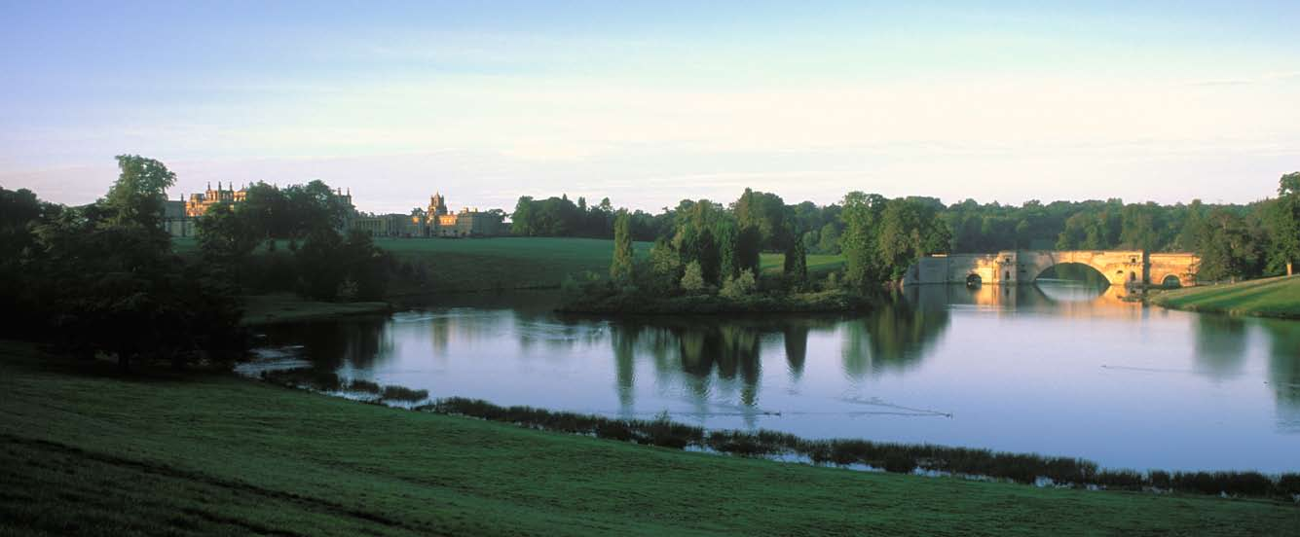
panoramas
3:2 lends itself for panoramic type views.
Note the way the eye travels across the frame.

Slide 13
verticals

Slide 14
Placement
Dead centre position are very stable – there is no dynamic movement in the photo

Slide 15
placement
Comment on
Placement
Size of subject
Area of interest around subject

Slide 16
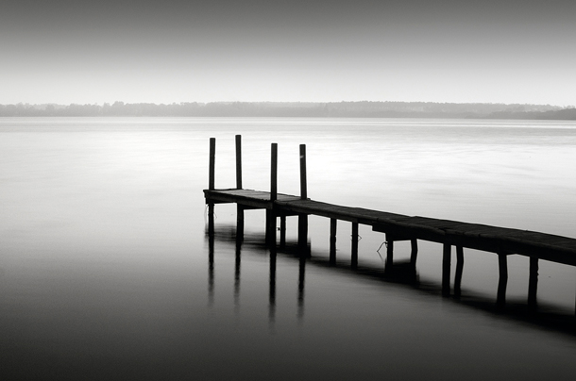
placement
Note shadows. Are they an integral part of the shot?
Note focal point and its size. How does the space around it work out?

Slide 17
Placement

